Slide 1
Progress report 2 – 12/14/2017

Slide 2
Why are sorting algorithms important?
25-50% of what computers do require sorting algorithms for
Efficiency
Speed
Processing data
Search engines (sorting through all websites to find relevant ones)
Graphical processes (layering is necessary)
Government organizations, financial institutions, commercial enterprises (Transactions, accounts, processing data)
Event driven simulations

Slide 3
What is Big data?
Big data
Collected by government, nasa, research institutions
data sets so large and complex that IT systems can not handle them- difficult to process data
Volume, velocity, variety, and veracity of data exceed storage or computing capacity
challenge of indexing, searching, transferring, and so on all increase exponentially

Slide 4

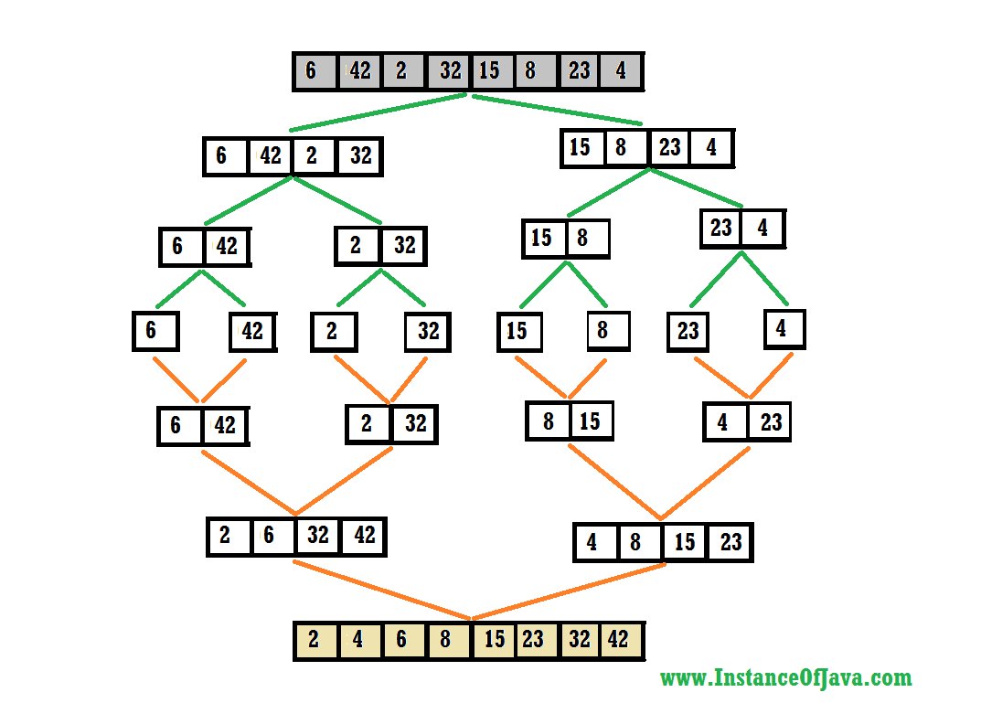
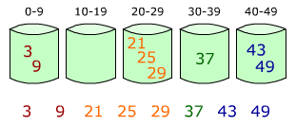
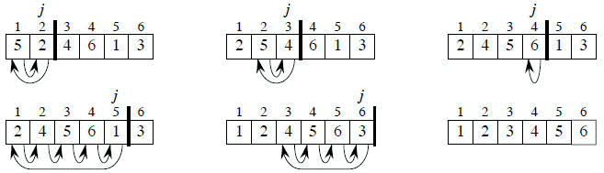
Sorting big data
Imagine you have 123,456,789 data elements you need to sort
You will use sorting algorithms (hopefully)
Merge sort = 998952457 operations
Bucket sort = 1.52 x 10^16 operations
Insertion sort = 1.52 x 10^16 operations
Companies have many servers and supercomputers so they can perform this in minutes using the same algorithms

Slide 5
Why is it difficult?
Too many passes (recursive iterations)
Each pass allocates its own heap in the memory (each pass has its own space)
Merge sort – many recursions
Bucket sort – memory is wasted, distributed data = uneven distribution amongst buckets (although this is a smart idea)
Insertion sort – solely based on comparing each element to every other one
TOO MUCH RAM REQUIRED, TOO MANY PASSES, TOO MUCH TIME

Slide 6
A better way to sort
Reduce compute time and ram requirements
Use statistical analysis to determine bucket ranges based on data set
<1000 elements in each bucket (number of elements are equal)
Should be able to sort data sets that follow any type of distribution
Worst case of O(n)

Slide 7
A visual representation
µ = 5.5
Median = 5.5
δ = 2.88
5 9 8 1 4 6
Bucket 1
Bucket 2
Bucket 3
-2δ to –.5δ
-.18δ to 0δ
0.1δ to 1δ
1 4 5 6 8 9
1 4
5 6
9 8

Slide 8
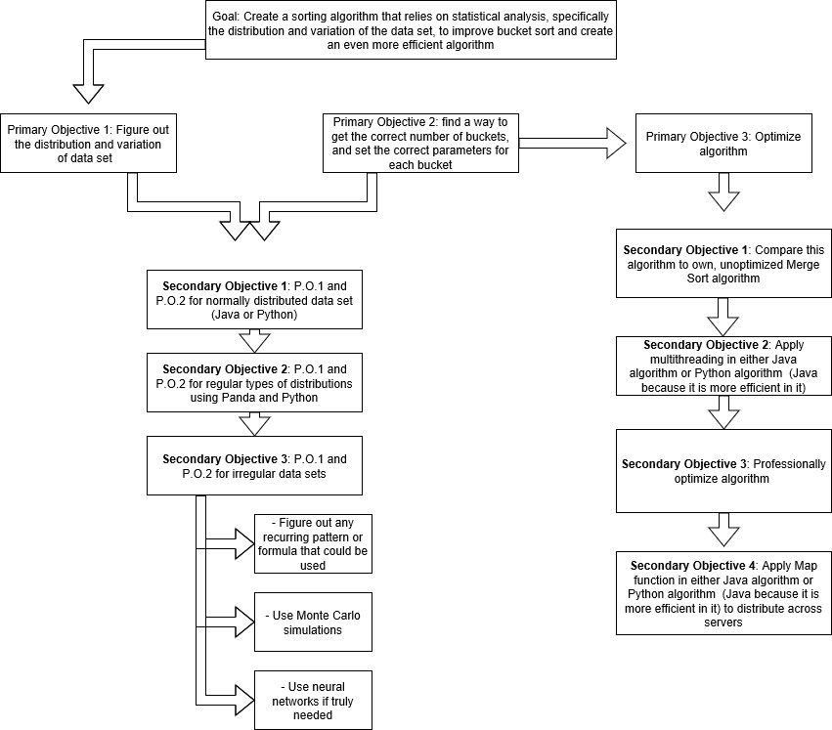

Slide 9
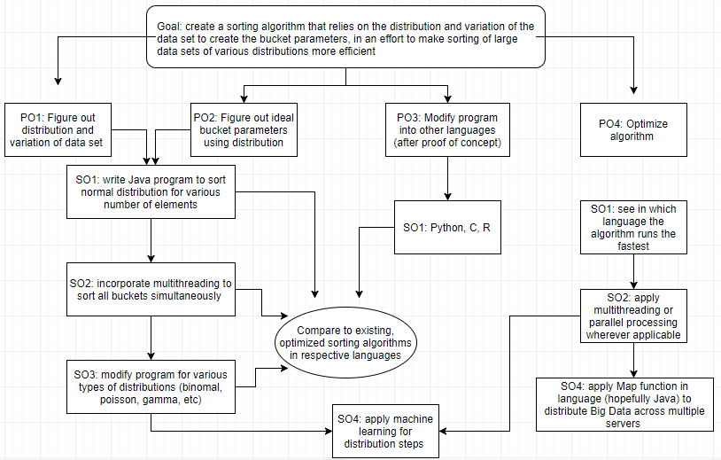

Slide 10
Progress upto progress report 1
Created backbone of algorithm in Java
Technical errors in preliminary code took time to figure out
Collected data when compared to Parallel Sort/Merge Sort
Transferring code into Python and learning Panda
Started communicating with Ms. Kumar

Slide 11
PROGRESS UPTO NOW
Finished programming normal distribution code in python
Encountered many problems while trying to reduce run time
Emailed Ms. Kumar about these issues
Tried to figure out solutions using numpy arrays and various numpy methods
Changed plan due to net progress and time
Learning how to multithread in java

Slide 12
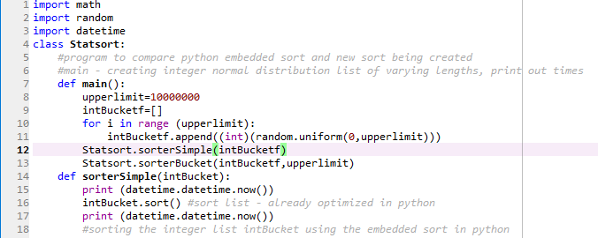
Python program
Creating random normal distribution data set
Sorting using built-in python sort (quicksort)

Slide 13
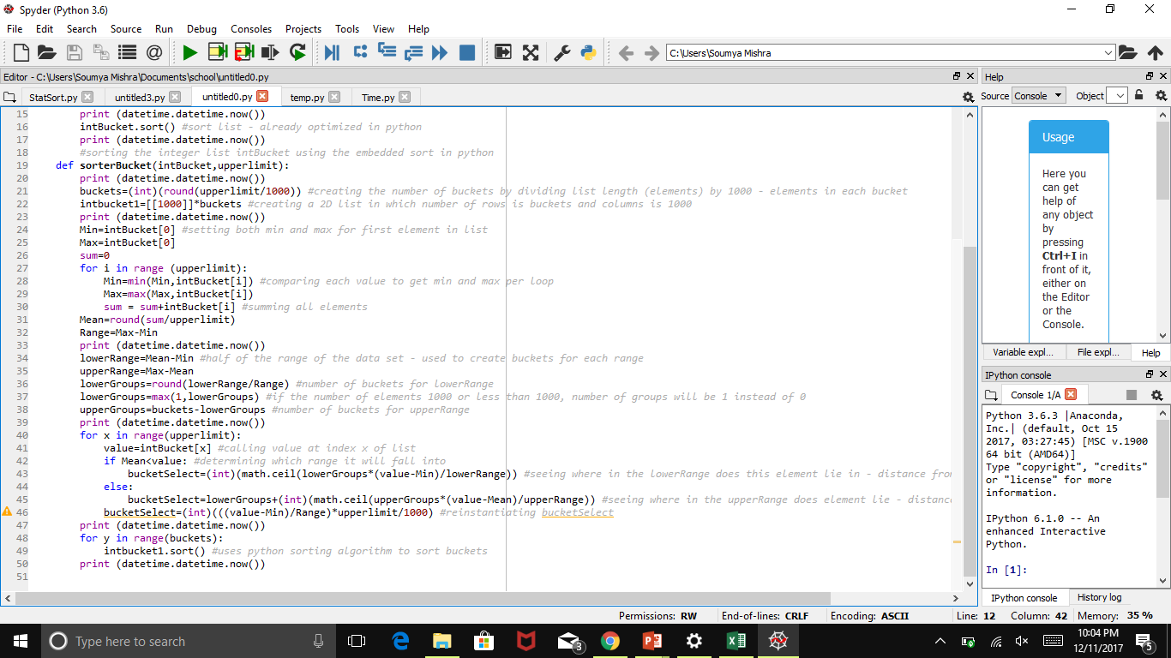
Python program
Creating 2D list in which elements are going to be stored
Obtaining Min, Max, Sum through use of FOR LOOP #1

Slide 14
Python program
Creating buckets
Assigning elements to their respective buckets based on distance from mean

Slide 15
Data collected (It does not work)
Elements | Python Sort |  |  | New Sort
 | Start Time (s) | End Time (s) | Total Time (s) | Start Time (s) | End Time (s) | Total Time (s)
1000 | 16.29 | 16.32 | 0.03 | 27.11 | 27.18 | 0.06
10000 | 13.76 | 13.82 | 0.06 | 24.13 | 24.25 | 0.12
100000 | 38.08 | 38.26 | 0.18 | 10.49 | 11.30 | 0.81
1000000 | 4.98 | 8.52 | 3.54 | 42.36 | 48.70 | 6.34
10000000 | 8.01 | 48.71 | 40.69 | 47.59 | 104.15 | 56.57

Slide 16
Data continued – why is it slower than java?
 | Parallel Sort (Optimized) |  |  |  | New Sort |  |  |  | Percent Faster (%)*
Elements | Trial 1 (s) | Trial 2 (s) | Trial 3 (s) | Average (s) | Trial 1 (s) | Trial 2 (s) | Trial 3 (s) | Average (s)
1000 | 0.31 | 0.20 | 0.27 | 0.26 | 0.01 | 0.02 | 0.02 | 0.01 | 95.40
10000 | 0.31 | 0.36 | 0.37 | 0.35 | 0.02 | 0.01 | 0.02 | 0.01 | 96.04
100000 | 0.24 | 0.25 | 0.28 | 0.26 | 0.05 | 0.08 | 0.07 | 0.07 | 74.03
1000000 | 0.62 | 0.68 | 0.51 | 0.61 | 0.16 | 0.16 | 0.13 | 0.15 | 74.82
10000000 | 0.48 | 1.25 | 1.24 | 0.99 | 0.26 | 0.54 | 0.47 | 0.42 | 57.32
100000000 | 5.71 | 5.91 | 5.82 | 5.81 | 3.31 | 3.06 | 3.40 | 3.26 | 44.01
10000000000 | HEAP ERROR
Here, in java, program runs SIGNIFICANTLY faster than parallel sort, merge sort, AND bucket sort
Why is the python SIGNIFICANTLY SLOWER AND INEFFICIENT

Slide 17
Further investigation
Trials | Time for Stat Collection (s) | Time for Bucketing (s) | Total Time (s)
1000 | 0.018 | 0.000 | 0.018
10000 | 0.030 | 0.052 | 0.082
100000 | 0.319 | 0.441 | 0.760
1000000 | 2.362 | 3.506 | 5.945
100000000 | 24.26 | 46.93 | 79.01
Time for collecting MIN, MAX, SUM, MEAN increases significantly from trials 4 to 5
Time for assigning elements to respective buckets increases significantly during same trials
These are the two places where FOR LOOPS are incorporated; other elements in the program are simple, one-step functions

Slide 18
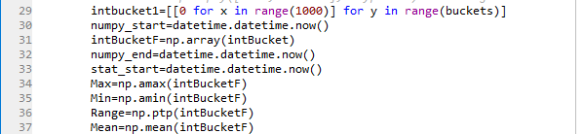
Possible solutions???
NUMPY ARRAYS
Have embedded MIN, MAX, RANGE, MEAN functions which can eliminate the FIRST FOR LOOP

Slide 19
more data
Elements | Python Sort |  |  | New Sort - with NumPy Array
 | Start Time (s) | End Time (s) | Total Time (s) | Start Time (s) | End Time (s) | Total Time (s)
1000 | 57.98 | 57.98 | 0.00 | 4.02 | 4.02 | 0.00
10000 | 4.13 | 4.14 | 0.02 | 48.44 | 48.58 | 0.14
100000 | 25.69 | 25.78 | 0.10 | 13.70 | 14.93 | 1.23
1000000 | 15.06 | 18.03 | 2.98 | 0.59 | 15.80 | 16.40
Run time has significantly decreased from before so the FOR LOOP was indeed affecting run time
Can time still be cut using numpy array for the 2D list as well?

Slide 20
MORE DATA
Python - Sort with Complete NumPy (Sort, Arrays)
Elements | Trials | Time for NumPy Array (s) | Time for Stat Collection (s) | Time for Bucketing (s) | Total Time (s) | Sort
1000 | AVG | 0 | 0.000 | 0.023 | 0.023 | 0.000
10000 | AVG | 0 | 0.000 | 0.157 | 0.162 | 0.005
100000 | AVG | 0.031 | 0.000 | 1.661 | 1.926 | 0.265
1000000 | AVG | 0.267 | 0.013 | 16.530 | 45.109 | 28.580
Time to create numpy array is gradually increasing – may cause problems when data set increases by factor of 100
Time for stat collection is negligible – suggests that numpy array does make it more efficient in this aspect
Time for bucketing with using numpy array
Why don’t the run times improve as much as expected?
QUICKSORT IS BEING USED TO SORT BUCKETS – EMBEDDED PYTHON PROGRAM

Slide 21
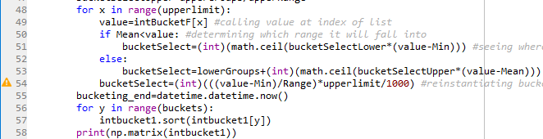
IS PYTHON THE RIGHT LANGUAGE?
CHECKED TO SEE IF PROGRAM WAS ACTUALLY WORKING THE WAY IT WAS
TRIED MULTIPLE WAYS TO PRINT OUT THE 2D LIST AND THE FINAL SORTED ARRAY BUT UNSUCCESSFUL
MAYBE DUE TO FAULTY PROGRAMMING
DUE TO “BEGINNER’S LEVEL” IN THIS LANGUAGE

Slide 22
DOES THIS PROGRAM EVEN WORK?
IT DID WORK MAGNIFICENTLY IN JAVA (ADVANCED LEVEL PROGRAMMING SKILL IN LANGUAGE)
DATA COLLECTED IN JAVA PROVES THAT IT DOES WORK
PROOF OF CONCEPT IS ESSENTIAL TO MAKE SURE EFFORTS ARE NOT WASTED
WILL JUST CONTINUE WITH COMPLETING FULL PROGRAM IN JAVA
PROOF OF CONCEPT

Slide 23
Next steps
Apply multithreading – sort buckets all at the same time
Modify algorithm to sort various types of distributions
Binomial
Poisson
Weibull
Log normal
Student’s t
Hypergeometric
MERELY THE FORMULA NEEDS TO CHANGE
Create a tool that will find distribution – if needed

